Slide 1
HR ANALYTICS
My try

Slide 2
Objective
We are provided with an employee attrition dataset.
Employee attrition refers to the dropping of employees
Our goals are as follows
Analyse why employees leave the firm – find out factors for it
Fit a logistic regression model with selected variables
Predict the probability that a given employee may leave the firm.
Plot the ROC curve
The jupyter notebook containing the code can be found in the repository

Slide 3
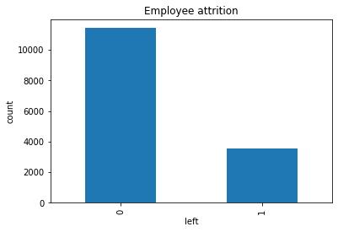
HR Analytics
Initially, we will have a look at the employee attrition rate
We see that the employee attrition rate is around 23.8 % (3571 out of 14999). This is not good for the company

Slide 4
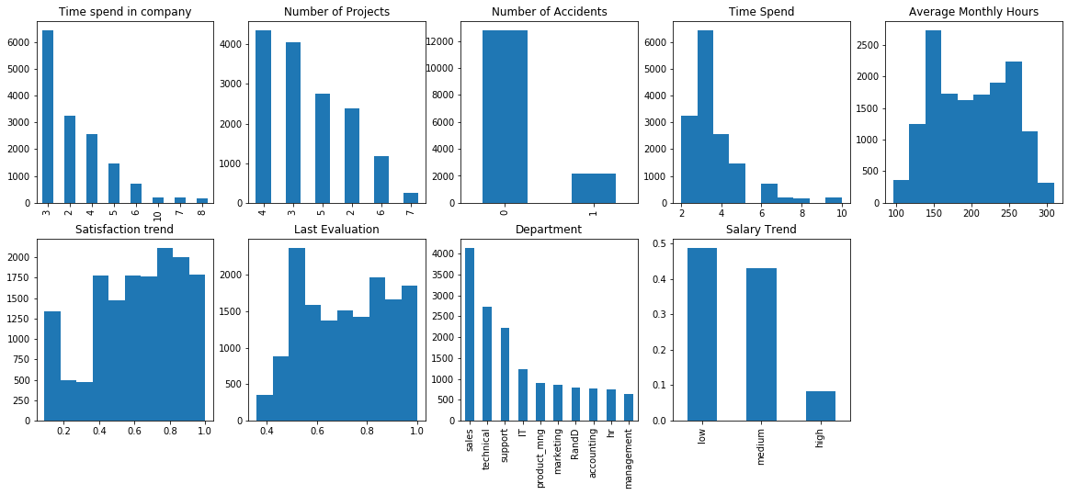
UNIVARIATE ANALYSIS
Now let us analyse each variable independently

Slide 5
Analysing each variable independently
It is seen that most employees,
have a work experience of 3 years
work on 4 projects
have low salary
work in sales department
Haven’t got promotion in last 5 years
But these data are useless. Actual Analyses begins when you compare other variables with your target variable i.e. left

Slide 6
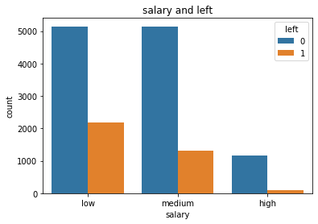
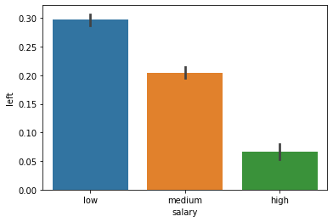
BIVARIATE ANALYSIS– SALARY AND LEFT

Slide 7
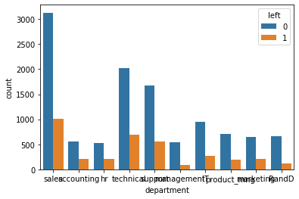
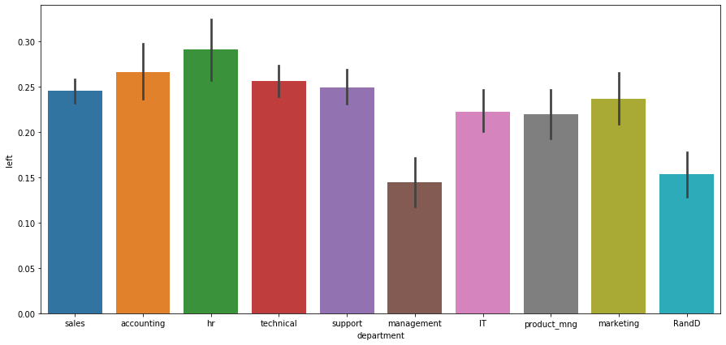
Departments Vs left

Slide 8
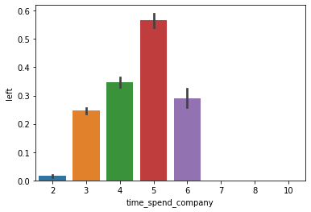
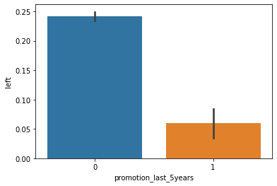
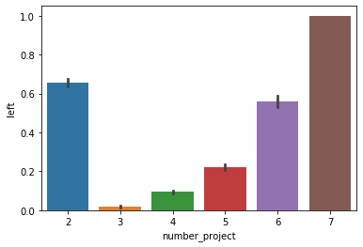
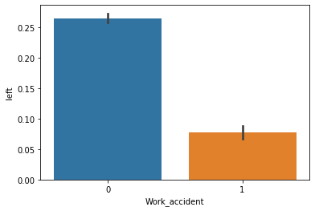
Other variables vs left

Slide 9
Conclusions
From the Bivariate analyses graphs, we can conclude the following statements
Employees with low are leaving in large percentage and those with high salary leave in lesser number
Employees of HR department are leaving maximum
Employees after 5 years of experience leave the firm and those with experience greater than 6 years haven’t left the firm
Employees without promotion leave more than that of the ones with promotions
Employees who have 7 projects leave at most
Employees who worked really less number of hours or worked a high number of hours leave the firm.
And average satisfaction levels of left and not left employees are 0.44 and 0.67 respectively

Slide 10
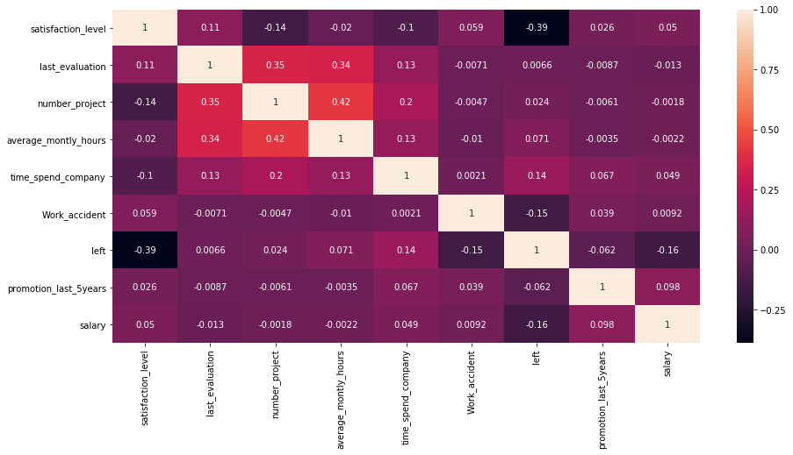
Correlation matrix
From the correlation matrix, it is seen that the variables -
Time_spend_company,
Average_monthly_hours,
Satisfaction_level and
Salary
have high correlation values with ‘left’

Slide 11
Applying logistic regression
From the previous analyses, we can chose 'satisfaction_level’, 'average_montly_hours’, 'promotion_last_5years’ and 'salary’ as important parameters while predicting attrition
After splitting the dataset into train and test sets, logistic regression was applied
The model had an accuracy score of 78 %
Probability of employees leaving the firm was predicted
ROC curve has been plotted
Other algorithms like Random Forest can be fitted for higher accuracy

Slide 12
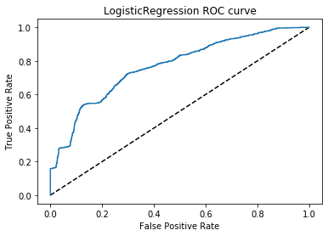
Roc curve
Logistic Regression AUC – 0.7686

